Slide 1
Stanly County Comprehensive Transportation Plan (CTP) Survey Results
Roger Castillo, Temilope Animashaun
August 6, 2024

Slide 2
AGENDA
Survey Results And feedback
SocioEconomic data for adoption
Base Year Volume/Capacity
Draft Destinations map
Notes:
https://demo.metroquestsurvey.com/sc5k5j

Slide 3
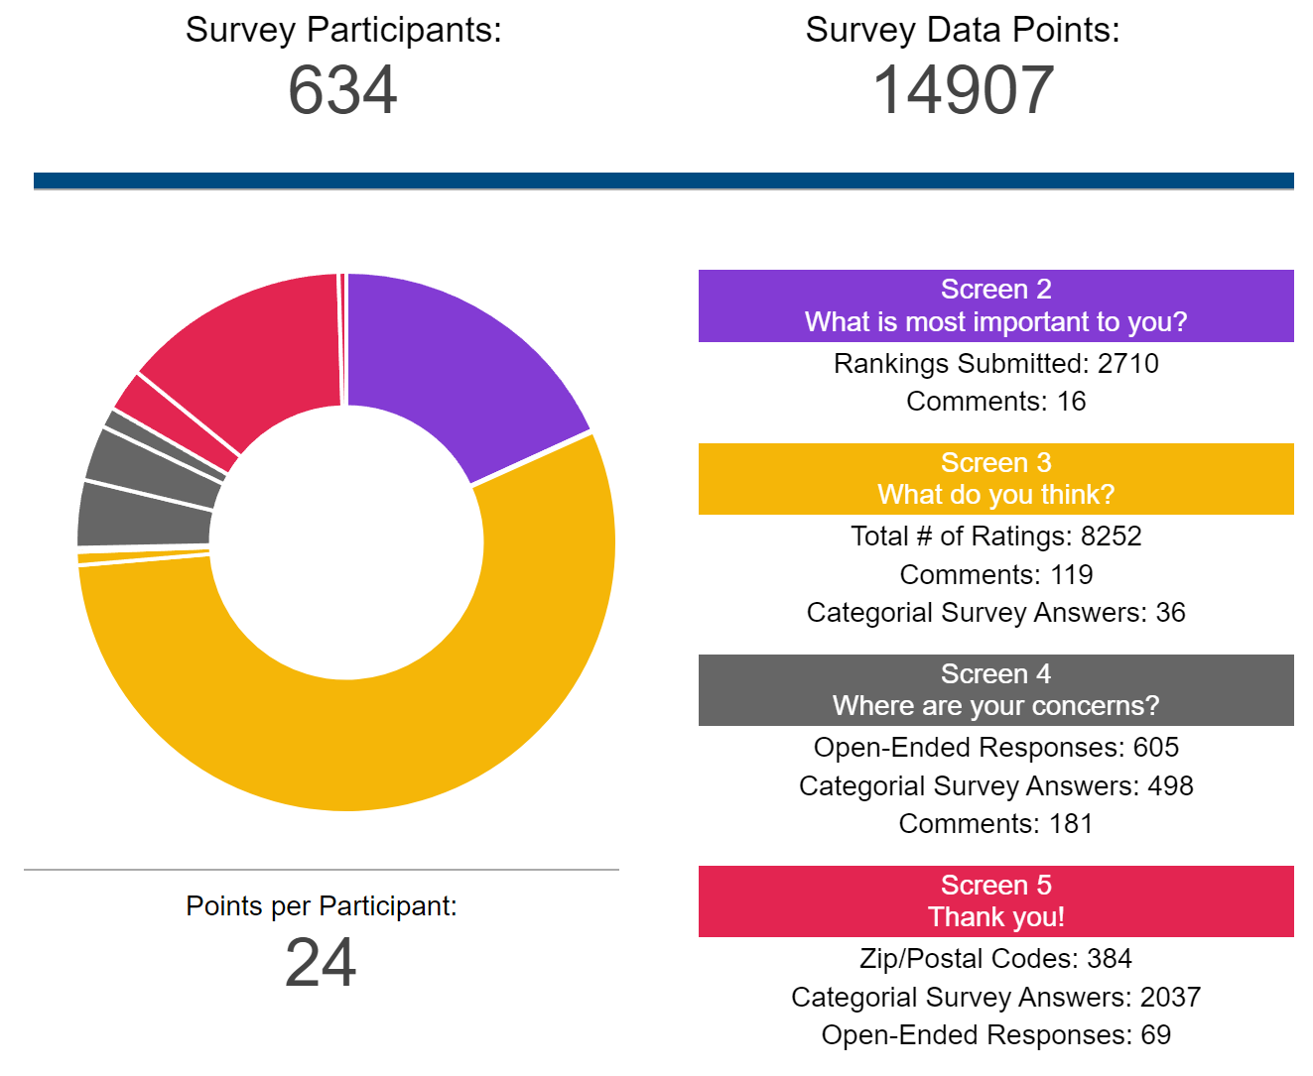
Stanly County CTP
SURVEY RESULTS
Who responded to the survey?
634Responses
~1% of the county population
58.86% Web
49.74% Mobile
1.4% Paper
Disclaimer: Every question is optional
Notes:
https://demo.metroquestsurvey.com/sc5k5j

Slide 4
Stanly County CTP
Demographics
2022 | USCB DATA
Age | 19%- 65 & Older
Ethnicity | 78%- White
Median Household Income | ~ $60,634
https://data.census.gov/profile/Stanly_County,_North_Carolina?g=050XX00US37167
Notes:
https://demo.metroquestsurvey.com/sc5k5j

Slide 5
Stanly County CTP
PRIORITY RANKING
Notes:
https://demo.metroquestsurvey.com/sc5k5j

Slide 6
Stanly County CTP
What do you think?
GENERAL QUESTIONS
I feel the roads in Anson County are safe
I feel the roads in Stanly County are congested
Average Rating:
3.37
Average Rating:
3.09
The current road network accommodates truck traffic well
It is important to prepare for future technologies
Average Rating:
2.93
Average Rating:
2.88
Notes:
https://demo.metroquestsurvey.com/sc5k5j

Slide 7
Stanly County CTP
What do you think?
ROADWAY
Road improvements are needed, even if they have unavoidable impacts
I am willing to exchange frequent access to driveways for more reliable travel time
Average Rating:
4.24
Average Rating:
3.22
I am in favor of widening roads to meet traffic demands
Intersections should be improved for easier navigation by large vehicles
Average Rating:
3.93
Average Rating:
4.01
Notes:
https://demo.metroquestsurvey.com/sc5k5j

Slide 8
Stanly County CTP
What do you think?
PUBLIC TRANSPORTATION
I am aware of the transportation options available in Stanly County.
Average Rating:
3.14
I am likely to use public transportation.
Average Rating:
2.23
Notes:
https://demo.metroquestsurvey.com/sc5k5j

Slide 9
Stanly County CTP
What do you think?
BICYCLING
There should be more places to bike safely
Bike lanes or paved shoulders should be included on roads where feasible.
Average Rating:
4.01
Average Rating:
3.91
I would prefer to ride a bike on a path outside the road than on the road.
Average Rating:
4.15
Notes:
https://demo.metroquestsurvey.com/sc5k5j

Slide 10
Stanly County CTP
What do you think?
PEDESTRIAN
More sidewalks are needed
I believe that existing sidewalks in Stanly County are in good condition
Average Rating:
4.09
Average Rating:
3.06
I think there should be more sidewalk connections to schools, parks, businesses, etc.
Average Rating:
4.08
Notes:
https://demo.metroquestsurvey.com/sc5k5j

Slide 11
Stanly County CTP
Mode of Transportation
# for each mode
318
50
Car
Transit
60
77
Pedestrian
Bike
24
Other
28
Truck
Notes:
https://demo.metroquestsurvey.com/sc5k5j

Slide 12
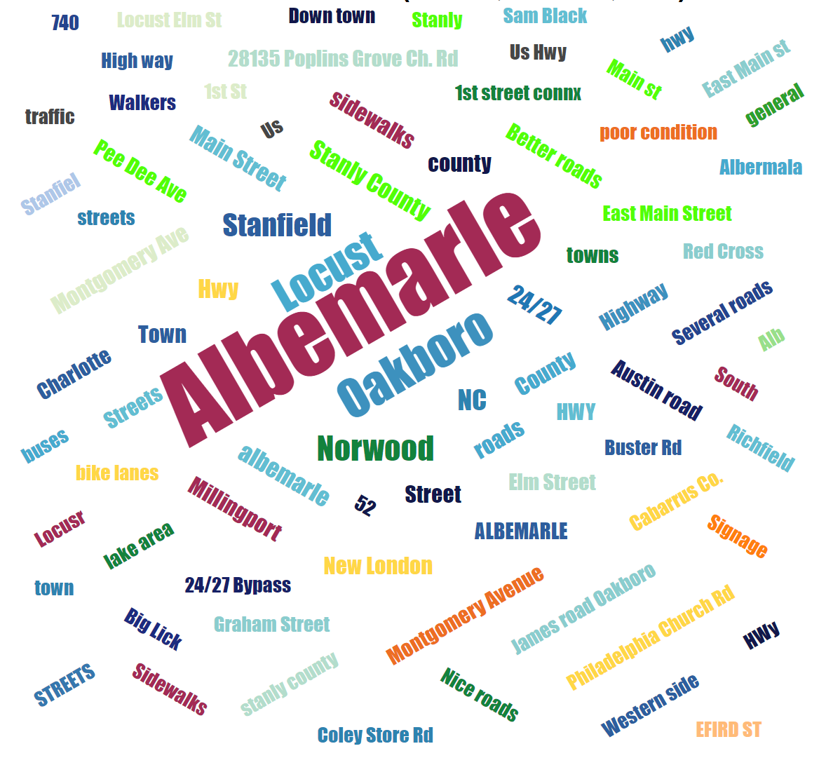
Stanly County CTP
Locations
Notes:
https://demo.metroquestsurvey.com/sc5k5j

Slide 13
Stanly County CTP
Car Concerns
Car (318 Concerns – 202 comments)
Comment Summary
Roads are in poor condition and need fixing.
HWY 73 between Albemarle and Concord is congested
Side streets and roadways with potholes need maintenance.
Dangerous intersections and visibility issues, particularly on 52 and 24/27.
Repeated concerns about four way stops causing congestion and confusion.
Speed and traffic enforcement is recommended
Overwhelming concerns about rapid growth and future development
Narrow streets Highways are narrow, and requests are to widen 49, 52, 72 and 24/27 to four lanes.
Re-mark roadway markings and signage for better navigation and nighttime visibility
Roundabouts - some comments supporting their installation while others advise against.
Implement speed bumps in residential areas
Some named streets: Montgomery St, E Main St, Bethany road, and Meadow Creek Church/Bethel Church Rd, Elm Street, Carike Rd, Bowers Rd, Snuggs Rd, Dennis Rd, etc.…
Notes:
https://demo.metroquestsurvey.com/sc5k5j

Slide 14
Stanly County CTP
Public/ Private Transit Concerns
Public Transportation (50 Concerns – 36 comments)
Comment Summary
Expand public transportation options and improve service to Charlotte and Concord.
Increase options for those with limited transportation.
Current SCUSA is inadequate for demand.
Educate people where to find public transit
Notes:
https://demo.metroquestsurvey.com/sc5k5j

Slide 15
Stanly County CTP
Truck Concerns
Trucks(24 Concerns – 19 comments)
Comment Summary
Speed enforcement needed on US 52
Widening needed for US 52 and Swift Road
Damage from new construction and large trucks
Heavy traffic from trucks, machinery, and mobile homes. Turn-off lanes and better road design needed.
Restricting trucks from using certain roads and ensuring they stick to designated routes like 24/27 is recommended
Installing proper traffic signals instead of stop signs
There is a call for improved transportation connections between towns to alleviate pressure on local roads.
Swift Road: Large trucks are reportedly struggling with sharp turns, causing safety issues for drivers.
High truck volume: Liberty Hill Church Road, West Main Street in Albemarle, Main Street in Norwood.
Notes:
https://demo.metroquestsurvey.com/sc5k5j

Slide 16
Stanly County CTP
Bicycle Concerns
Bicycle (60 Concerns – 44 comments)
Comment Summary
Need wider roads and dedicated bike lanes.
Lack of safe and enjoyable bike paths.
Safe bike path to the local parks are needed.
Bicyclists show an interest in constructing bike lanes on both rural and urban streets. Specific locations referenced include Highways 52 , 24/27 as well as roads connecting Locust and Stanfield.
Concern for bicycle recreation on roads around City Lake Park, Carolina Avenue Park, and other parks in the area.
Rumble strips push riders into the lane creating hazards
Moving bikes off the roadway to the sidewalk.
Greenways are highly recommended by commenters.
Notes:
https://demo.metroquestsurvey.com/sc5k5j

Slide 17
Stanly County CTP
Pedestrian Concerns
Pedestrian (77 Concerns – 51 comments)
Unsafe walking conditions, blocked sidewalks, and poor visibility.
Sidewalks needed along 24/27 and connecting James Rd to other areas.
Pedestrian lights, sidewalks, and safer crosswalks are needed near grocery and retail stores.
Walking trails are unsafe due to criminal activity.
Addressing homelessness and cleanliness to ensure safety in greenways and other public spaces.
Interaction between pedestrians and vehicles, with safety hazards on streets like Pee Dee Ave and near Walmart.
Sidewalks need better maintenance, including repairing uneven surfaces and dealing with issues like old, crumbling sidewalks and obstacles like utility poles.
Completion of the sidewalk from Pfeiffer University to Richfield
Sidewalks along Hwy 200, Sunset Lake Road, and connecting neighborhoods on Elm Street.
Comment Summary
Notes:
https://demo.metroquestsurvey.com/sc5k5j

Slide 18
Stanly County CTP
Other Concerns
Other Issues (28 Concerns – 25 comments)
Address train and stoplight issues at St. Martin and Hwy 205.
There is a concern about preserving rural communities and farmland
Requests for improved access points, such as a second turn lane at grocery stores or a U-turn option, to facilitate better traffic flow and reduce congestion.
Areas with high traffic, especially near shopping centers, need better design to manage congestion. Suggestions include adding side or back entrances to reduce traffic pressure.
Address transportation issues caused by increased traffic from Charlotte Pipe and railroad schedules. Improve road conditions on Big Lick Rd and Liberty Hill Church Road to manage traffic better.
Encourage an active Chamber of Commerce to attract new industries and promote Stanly County effectively. The Board of Commissioners should seek ways to highlight the county’s strengths to potential businesses
Comment Summary
Notes:
https://demo.metroquestsurvey.com/sc5k5j

Slide 19
Socioeconomic Data
Stanly County CTP
Stanly County Population (1.7% annual growth)
Year | 2022 | 2025 | 2030 | 2045 | 2050 | 2055
Population | 64,153 | 67,346 | 72,667 | 88,632 | 93,953 | 99,275
56.1% overall population growth (35,122 increase)
Stanly County Employment (1% annual growth)
Year | 2022 | 2025 | 2030 | 2045 | 2050 | 2055
Employment | 28,739 | 29,636 | 31,130 | 35,613 | 37,108 | 38,602
33% overall population growth (9,863 increase)

Slide 20
Contacts
Stanly County CTP
NCDOT Transportation Planning Division (TPD)
Temilope Animashaun, tmanimashaun@ncdot.gov, (919)-707-0931 (Project Engineer)
Roger Castillo, ricastillo@ncdot.gov, (919) 707-0942 (Project Manager)
Rocky River Rural Planning Organization (RPO)
Lee Snuggs, lsnuggs@rockyriverrpo.org, (704) 986-3871

Slide 21
QUESTIONS

